Slide 1
Principles of Database Design and Programming CST 217
Nasser Tadayon

Slide 2
Data versus Information
Data:
Raw facts
Have not yet been processed to reveal their meaning to the end user
Building blocks of information
Data management
Generation, storage, and retrieval of data
Information:
Produced by processing raw data to reveal its meaning
Requires context
Core of knowledge
Should be accurate, relevant, and timely to enable good decision making

Slide 3
Introducing the Database
Shared, integrated computer structure that stores a collection of:
End-user data - Raw facts of interest to end user
Metadata: Data about data, which the end-user data are integrated and managed
Describe data characteristics and relationships
Database management system (DBMS)
Collection of programs
Manages the database structure
Controls access to data stored in the database

Slide 4
Role of the DBMS
Intermediary between the user and the database
Enables data to be shared
Presents the end user with an integrated view of the data
Receives and translates application requests into operations required to fulfill the requests
Hides database’s internal complexity from the application programs and users

Slide 5
The DBMS Manages the Interaction between the End User and the Database

Slide 6
Advantages of the DBMS
Better data integration and less data inconsistency
Data inconsistency: Different versions of the same data appear in different places
Increased end-user productivity
Improved:
Data sharing
Data security
Data access
Decision making
Data quality: Accuracy, validity, and timeliness of data

Slide 7
The Database System Environment

Slide 8
DBMS Functions
Data dictionary management
Data dictionary: Stores definitions of the data elements and their relationships
Data storage management
Performance tuning: Ensures efficient performance of the database in terms of storage and access speed
Data transformation and presentation
Transforms entered data to conform to required data structures
Security management
Enforces user security and data privacy

Slide 9
DBMS Functions
Database access languages and application programming interfaces
Query language: Lets the user specify what must be done without having to specify how
Structured Query Language (SQL): De facto query language and data access standard supported by the majority of DBMS vendors
Database communication interfaces
Accept end-user requests via multiple, different network environments

Slide 10
Data Modeling
Data modeling: Data modeling is a technique to document a software system using diagrams and symbols.
It is used to represent communication of data.
Iterative and progressive process of creating a specific data model for a determined problem domain.
Useful for supporting a specific problem domain.
Give an overall view of the database
Organize data for various users

Slide 11
Data Model Basic Building Blocks
Entity: Unique and distinct object used to collect and store data
Attribute: Characteristic of an entity
Relationship: Describes an association among entities
One-to-many (1:M)
Many-to-many (M:N or M:M)
One-to-one (1:1)
Constraint: Set of rules to ensure data integrity

Slide 12
Business Rules
Brief, precise, and unambiguous description of a policy, procedure, or principle
Enable defining the basic building blocks
Describe main and distinguishing characteristics of the data

Slide 13
Sources of Business Rules
Customer
Policy makers
Department managers
Written documentation
Direct interviews with end users
Company managers

Slide 14
Reasons for Identifying and Documenting Business Rules
Help standardize company’s view of data
Communications tool between users and designers
Allow designer to:
Understand the nature, role, scope of data, and business processes
Develop appropriate relationship participation rules and constraints
Create an accurate data model

Slide 15
Translating Business Rules into Data Model Components
Nouns translate into entities
Verbs translate into relationships among entities
Relationships are bidirectional
Questions to identify the relationship type
How many instances of B are related to one instance of A?
How many instances of A are related to one instance of B?

Slide 16
Naming Conventions
Entity names - Required to:
Be descriptive of the objects in the business environment
Use terminology that is familiar to the users
Attribute name - Required to be descriptive of the data represented by the attribute
Proper naming:
Facilitates communication between parties
Promotes self-documentation

Slide 17
Standard Database Concepts
Schema
Conceptual organization of the entire database as viewed by the database administrator
Subschema
Portion of the database seen by the application programs that produce the desired information from the data within the database

Slide 18
Standard Database Concepts
Data Manipulation Language (DML)
Environment in which data can be managed and is used to work with the data in the database
Data Definition Language (DDL)
Enables the database administrator to define the schema components

Slide 19
The Relational Model
Produced an automatic transmission database that replaced standard transmission databases
Based on a relation
Relation or table: Matrix composed of intersecting tuple and attribute
Tuple: Rows
Attribute: Columns
Describes a precise set of data manipulation constructs

Slide 20
The Entity Relationship Model
Graphical representation of entities and their relationships in a database structure
Entity relationship diagram (ERD)
Uses graphic representations to model database components
Entity instance or entity occurrence
Rows in the relational table
Connectivity: Term used to label the relationship types

Slide 21
The ER Model Notations

Slide 22
NoSQL Databases
Not based on the relational model
Support distributed database architectures
Provide high scalability, high availability, and fault tolerance
Support large amounts of sparse data
Geared toward performance rather than transaction consistency
Store data in key-value stores

Slide 23
A Simple Key-Value Representation

Slide 24
Entity Relationship Model
Advantages
Disadvantages
Visual modeling yields conceptual simplicity
Visual representation makes it an effective communication tool
Is integrated with the dominant relational model
Limited constraint representation
Limited relationship representation
No data manipulation language
Loss of information content occurs when attributes are removed from entities to avoid crowded displays

Slide 25
NoSQL
Advantages
Disadvantages
High scalability, availability, and fault tolerance are provided
Uses low-cost commodity hardware
Supports Big Data
Key-value model improves storage efficiency
Complex programming is required
There is no relationship support
There is no transaction integrity support
In terms of data consistency, it provides an eventually consistent model

Slide 26
Data Abstraction Levels

Slide 27
The External Model
End users’ view of the data environment
ER diagrams are used to represent the external views
External schema: Specific representation of an external view

Slide 28
External Models For Tiny College

Slide 29
The Conceptual Model
Represents a global view of the entire database by the entire organization
Conceptual schema: Basis for the identification and high-level description of the main data objects
Has a macro-level view of data environment
Is software and hardware independent
Logical design: Task of creating a conceptual data model

Slide 30
Conceptual Model For Tiny College

Slide 31
The Internal Model
Representing database as seen by the DBMS mapping conceptual model to the DBMS
Internal schema: Specific representation of an internal model
Uses the database constructs supported by the chosen database
Is software dependent and hardware independent
Logical independence: Changing internal model without affecting the conceptual model

Slide 32
Internal Model for Tiny College

Slide 33
The Physical Model
Operates at lowest level of abstraction
Describes the way data are saved on storage media such as disks or tapes
Requires the definition of physical storage and data access methods
Relational model aimed at logical level
Does not require physical-level details
Physical independence: Changes in physical model do not affect internal model

Slide 34
Levels of Data Abstraction

Slide 35
Characteristics of a Relational Table

Slide 36
Keys
Consist of one or more attributes that determine other attributes
Used to:
Ensure that each row in a table is uniquely identifiable
Establish relationships among tables and to ensure the integrity of the data
Primary key (PK): Attribute or combination of attributes that uniquely identifies any given row

Slide 37
Dependencies
Functional dependence: Value of one or more attributes determines the value of one or more other attributes
Determinant: Attribute whose value determines another
Dependent: Attribute whose value is determined by the other attribute
Full functional dependence: Entire collection of attributes in the determinant is necessary for the relationship

Slide 38
Types of Keys
Composite key: Key that is composed of more than one attribute
Key attribute: Attribute that is a part of a key
Entity integrity: Condition in which each row in the table has its own unique identity
All of the values in the primary key must be unique
No key attribute in the primary key can contain a null

Slide 39
Types of Keys
Null: Absence of any data value that could represent:
An unknown attribute value
A known, but missing, attribute value
A inapplicable condition
Referential integrity: Every reference to an entity instance by another entity instance is valid
Secondary key: Key used strictly for data retrieval purposes

Slide 40
An Example of a Simple Relational Database

Slide 41
Relational Database Keys

Slide 42
Integrity Rules

Slide 43
An Illustration of Integrity Rules

Slide 44
Ways to Handle Nulls
Flags: Special codes used to indicate the absence of some value
NOT NULL constraint - Placed on a column to ensure that every row in the table has a value for that column
UNIQUE constraint - Restriction placed on a column to ensure that no duplicate values exist for that column

Slide 45
Data Dictionary and the System Catalog
Data dictionary: Description of all tables in the database created by the user and designer
System catalog: System data dictionary that describes all objects within the database
Homonyms and synonyms must be avoided to lessen confusion
Homonym: Same name is used to label different attributes
Synonym: Different names are used to describe the same attribute

Slide 46
Relationships within the Relational Database
1:M relationship - Norm for relational databases
1:1 relationship - One entity can be related to only one other entity and vice versa
Many-to-many (M:N) relationship - Implemented by creating a new entity in 1:M relationships with the original entities
Composite entity (Bridge or associative entity): Helps avoid problems inherent to M:N relationships, includes the primary keys of tables to be linked

Slide 47
The 1:1 Relationship between PROFESSOR and DEPARTMENT

Slide 48
Changing the M:N Relationship to Two 1:M Relationships

Slide 49
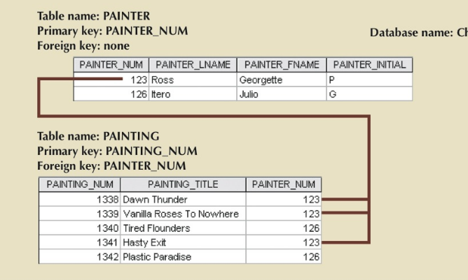
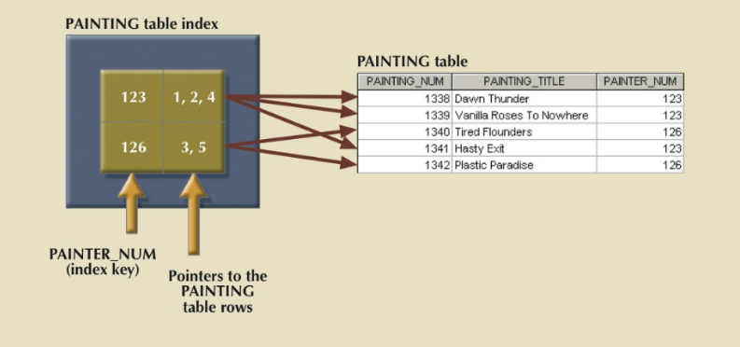
Indexes
Orderly arrangement to logically access rows in a table
Index key: Index’s reference point that leads to data location identified by the key
Unique index: Index key can have only one pointer value associated with it
Each index is associated with only one table

Slide 50
Attributes
Characteristics of entities
Required attribute: Must have a value, cannot be left empty
Optional attribute: Does not require a value, can be left empty
Domain - Set of possible values for a given attribute
Identifiers: One or more attributes that uniquely identify each entity instance

Slide 51
The Attributes of the Student Entity: Chen and Crow’s Foot

Slide 52
Attributes
Composite identifier: Primary key composed of more than one attribute
Composite attribute: Attribute that can be subdivided to yield additional attributes
Simple attribute: Attribute that cannot be subdivided
Single-valued attribute: Attribute that has only a single value
Multivalued attributes: Attributes that have many values

Slide 53
A Multivalued Attribute in an Entity

Slide 54
Attributes
Multivalued attributes: Attributes that have many values and require creating:
Several new attributes, one for each component of the original multivalued attribute
A new entity composed of the original multivalued attribute’s components
Derived attribute: Attribute whose value is calculated from other attributes
Derived using an algorithm

Slide 55
Advantages and Disadvantages of Storing Derived Attributes

Slide 56
Relationships
Association between entities that always operate in both directions
Participants: Entities that participate in a relationship
Connectivity: Describes the relationship classification
Cardinality: Expresses the minimum and maximum number of entity occurrences associated with one occurrence of related entity

Slide 57
Connectivity and Cardinality in an ERD

Slide 58
Relationship Strength
Weak (non-identifying) relationship
Primary key of the related entity does not contain a primary key component of the parent entity
Strong (identifying) relationships
Primary key of the related entity contains a primary key component of the parent entity

Slide 59
A Weak (Non-Identifying) Relationship between COURSE and CLASS

Slide 60
A Strong (Identifying) Relationship between COURSE and CLASS

Slide 61
Weak Entity
Conditions
Existence-dependent
Has a primary key that is partially or totally derived from parent entity in the relationship
Database designer determines whether an entity is weak based on business rules

Slide 62
A Weak Entity in an ERD

Slide 63
A Weak Entity in a Strong Relationship

Slide 64
Relationship Participation
Optional participation
One entity occurrence does not require a corresponding entity occurrence in a particular relationship
Mandatory participation
One entity occurrence requires a corresponding entity occurrence in a particular relationship

Slide 65
Crow’s Foot Symbols

Slide 66
Relationship Degree
Indicates the number of entities or participants associated with a relationship
Unary relationship: Association is maintained within a single entity
Recursive relationship: Relationship exists between occurrences of the same entity set
Binary relationship: Two entities are associated
Ternary relationship: Three entities are associated

Slide 67
Three Types of Relationship Degree

Slide 68
An ER Representation of Recursive Relationships

Slide 69
Associative (Composite) Entities
Used to represent an M:N relationship between two or more entities
Is in a 1:M relationship with the parent entities
Composed of the primary key attributes of each parent entity
May also contain additional attributes that play no role in connective process

Slide 70
Converting the M:N Relationship into Two 1:M Relationships

Slide 71
A Composite Entity in an ERD

Slide 72
Developing an ER Diagram
Create a detailed narrative of the organization’s description of operations
Identify business rules based on the descriptions
Identify main entities and relationships from the business rules
Develop the initial ERD
Identify the attributes and primary keys that adequately describe entities
Revise and review ERD

Slide 73
The First Tiny College ERD Segment

Slide 74
The Second Tiny College ERD Segment

Slide 75
The Third Tiny College ERD Segment

Slide 76
The Fourth Tiny College ERD Segment

Slide 77
The Fifth Tiny College ERD Segment

Slide 78
The Sixth Tiny College ERD Segment

Slide 79
The Seventh Tiny College ERD Segment

Slide 80
The Eighth Tiny College ERD Segment

Slide 81
The Ninth Tiny College ERD Segment

Slide 82
Components of the ERM

